Slide 1
Limit Orders
By: Naveno Cendikiawan

Slide 2
Market orders VS limit orders
Current Price
Immediately
Specific Price
Delay

Slide 3
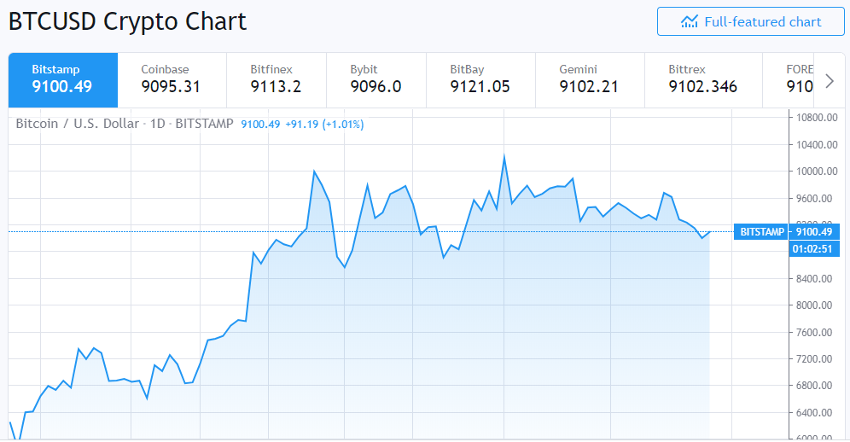
Analyze the market
Notes:
Uncertainty of future bitcoin’s value is one reason why it is quite volatile. The graph shows the BTC-USD (Bitcoin price relative to USD) for the past 3 months.

Slide 4
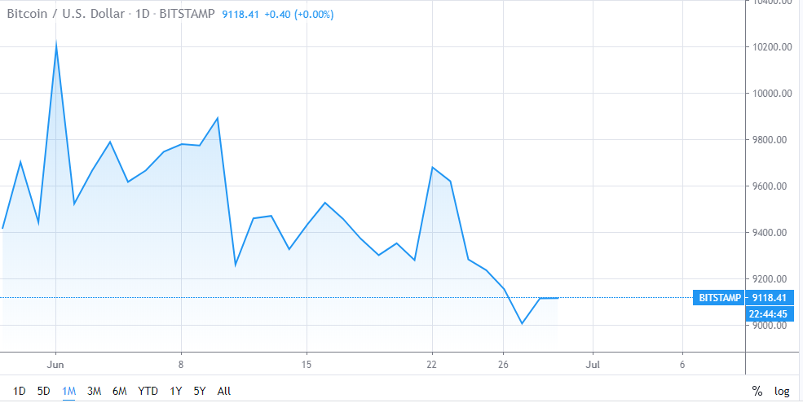
Analyze the market
Notes:
You can also try to see the market price in that current month, or even past few days to better analyze the market.
Rough estimation and guess the specified buy and selling price limit.

Slide 5
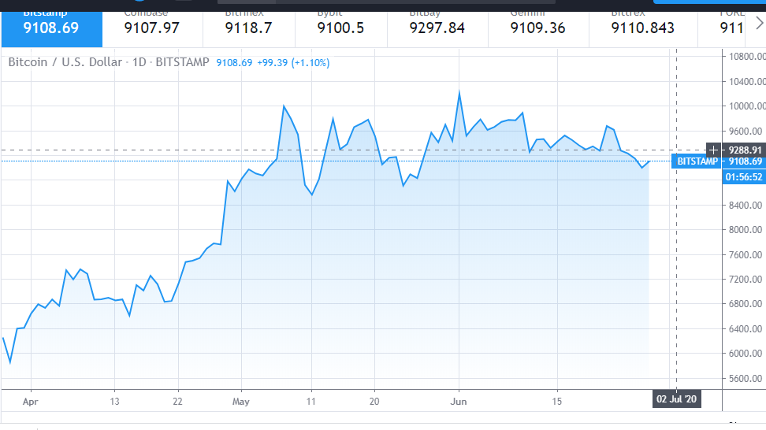
Set buy limit
Notes:
I set the buying price to 9285

Slide 6


Set profit target
Notes:
Next, in order to set the selling price, you need to have your profit target, the expected value you get in return.
Since Bitcoin’s value is quite volatile, I didn’t really hope much in return.
Also, since the strategy will be executed for only two weeks, I didn’t set the selling price too high.

Slide 7

Set sell limit
Notes:
Finally, you can set the selling price: 9310.
There are some worse cases: 1. You set the buying price too low, so no order will be executed, resulting 0 ROI, not including the commission fees.
2. You set the selling price too high, so you might have to wait a long time for it to return, or you might even have to sell it before it even reached your specified price.

Slide 8
advantages
Provides certainty & control.
Can be of particular benefit in a market with high volatility.
Notes:
Assured the buying and selling price is at least as good as the specified price. They provide traders with precise control over the execution price of the orders they place.
This method can protect investors from unusual volatility in market. (because the price is set, you don’t have to worry about the market being too volatile)

Slide 9
limitations
Miss a trading opportunity
Might have to wait a long time
Higher commission cost
Notes:
You should use limit orders when you are not in a rush to buy or sell.
Limit orders are not executed instantly, so you need to wait until your specified price is reached.
You might have to wait a long time before the market price reached your specified price.
In investment, typically, the commission cost are more expensive than for market orders.
But it is always a good idea to use because we have more control over the price.

Slide 10
Thank you!

